Slide 1
Water pollution
Water pollution (or aquatic pollution) is the contamination of water bodies, with a negative impact on their uses.^{[1]: 6} It is usually a result of human activities. Water bodies include lakes, rivers, oceans, aquifers, reservoirs and groundwater. Water pollution results when contaminants mix with these water bodies. Contaminants can come from one of four main sources. These are sewage discharges, industrial activities, agricultural activities, and urban runoff including stormwater.^{[2]} Water pollution may affect either surface water or groundwater. This form of pollution can lead to many problems. One is the degradation of aquatic ecosystems. Another is spreading water-borne diseases when people use polluted water for drinking or irrigation.^{[3]} Water pollution also reduces the ecosystem services such as drinking water provided by the water resource.

Slide 2
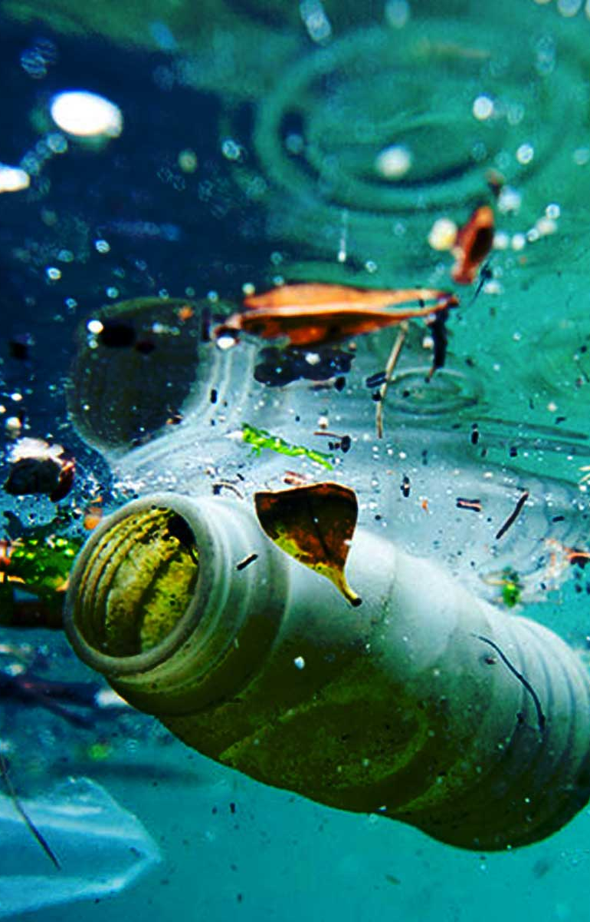
Water become waste
Water pollution can be defined as the contamination of water bodies. Water pollution is caused when water bodies such as rivers, lakes, oceans, groundwater and aquifers get contaminated with industrial and agricultural effluents.

Slide 3
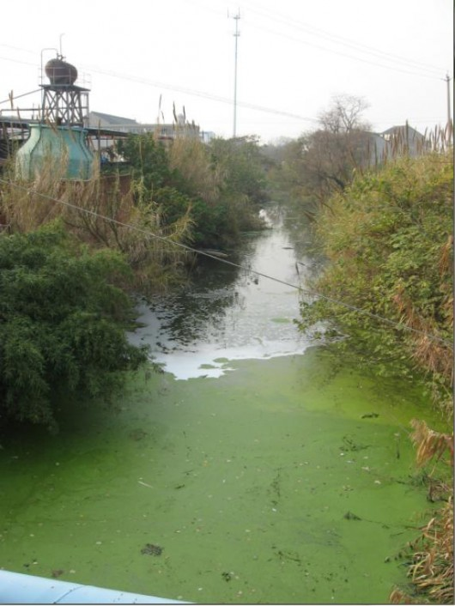
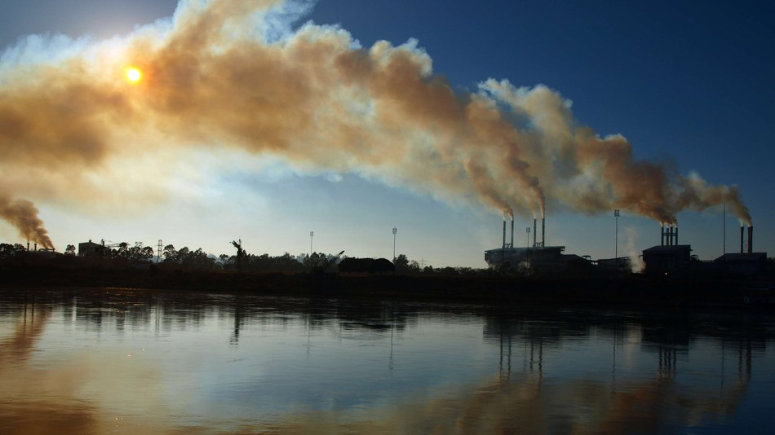
Sources Of Water Pollution
The key causative of water pollution in India are:
Urbanization.
Deforestation.
Industrial effluents.
Social and Religious Practices.
Use of Detergents and Fertilizers.
Agricultural run-offs- Use of insecticides and pesticides.

Slide 4
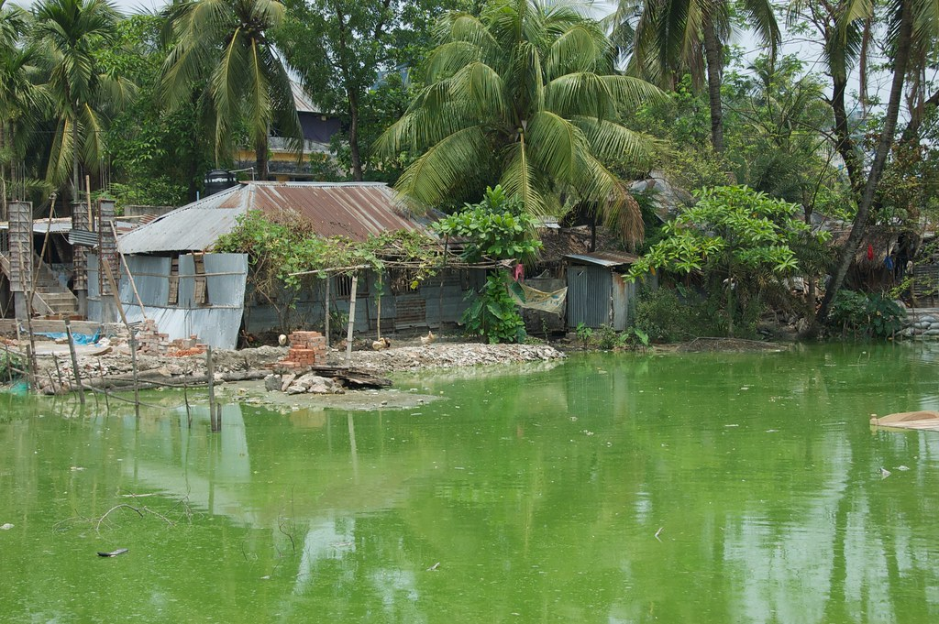
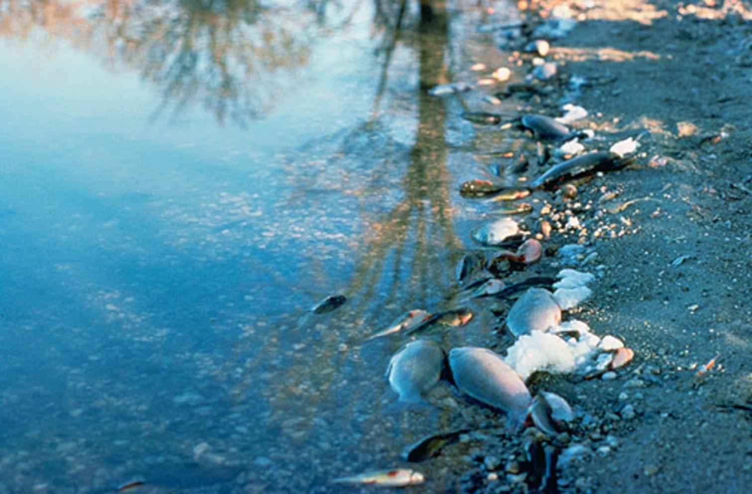
Water
Present in the world
Absent in the world
Most people have heard Earth referred to as "the water planet." With that name comes the rightful image of a world with plentiful water. In photographs taken from space, we can see that our planet has more water than land. However, of all the water on Earth, more than 99 percent of Earth's water is unusable by humans and many other living things - only about 0.3 percent of our fresh water is found in the surface water of lakes, rivers, and swamps.
Billions of people around the world lack adequate access to one of the essential elements of life: clean water. Although governments and aid groups have helped many living in water-stressed regions gain access in recent years, the problem is projected to get worse due to global warming and population growth.

Slide 5
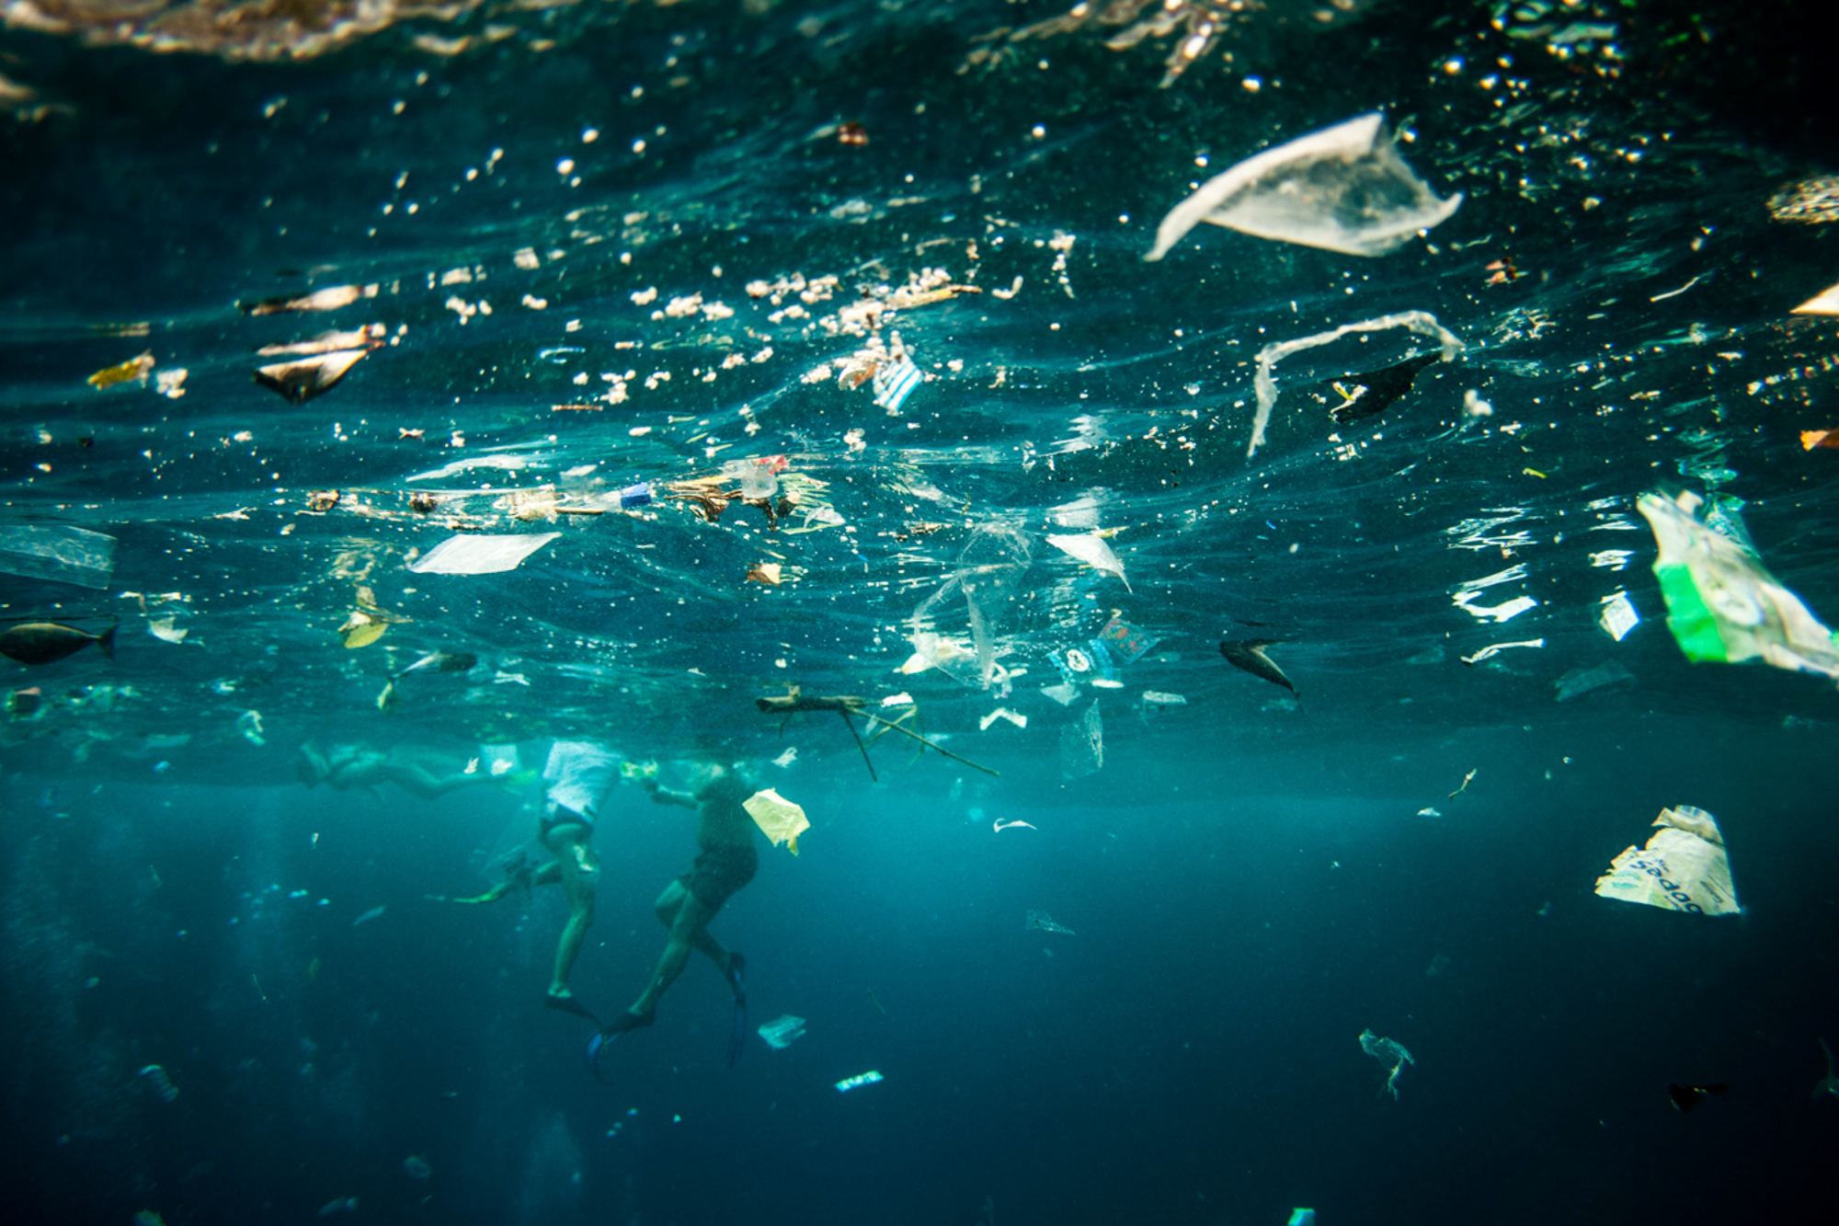
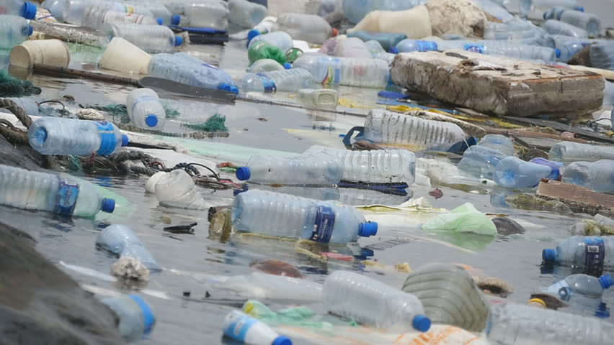
water play a very important role in life
Water is a major component of your body, accounting for 50–60% of your total weight.¹ It is vital for many important body functions, from flushing out waste to lubricating your joints.
Your body constantly loses water throughout the day through urinating, sweating, and breathing. You should consume enough water from foods and beverages daily to prevent dehydration.
1. It helps create saliva
2. It regulates your body temperature
3. It protects your tissues, spinal cord, and joints
4. It helps excrete waste through perspiration, urination, and defecation
5. It helps maximize physical performance

